Slide 1

GAUSSIAN NOISE
Nada Janković 468-12

Slide 2
Image Processing
ONE PIXEL

Slide 3

Image Processing + Dataflow
ONE PIXEL

Slide 4

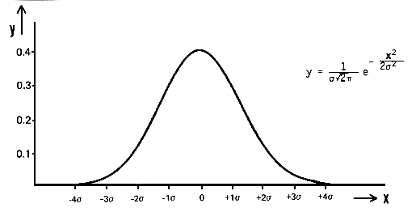

Formula

Slide 5
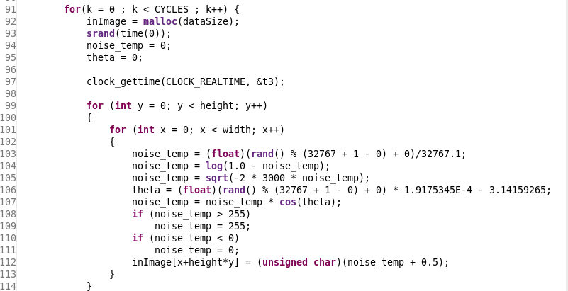
Sequential Code

Slide 6
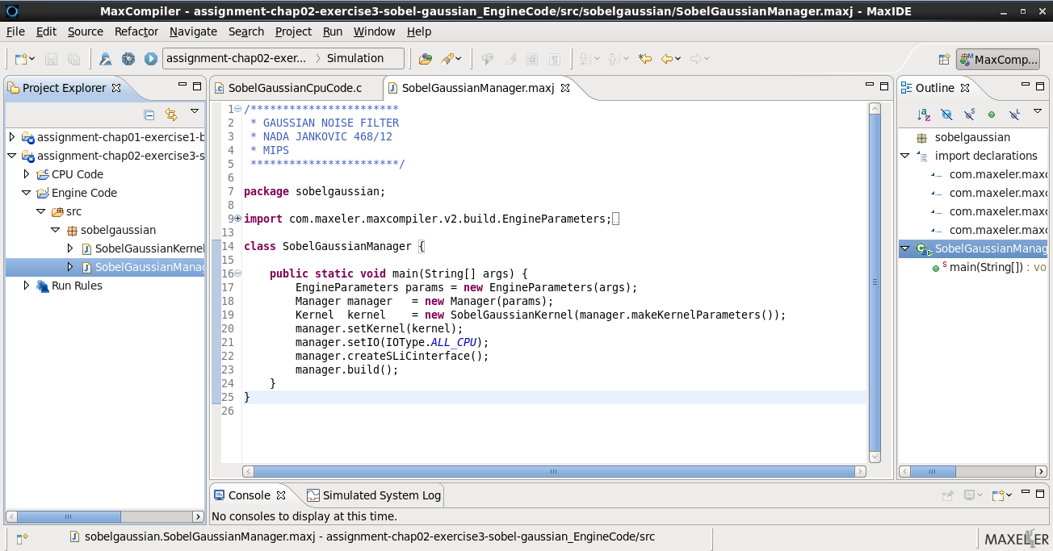
Maxeler Manager

Slide 7
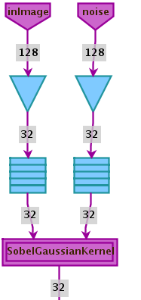
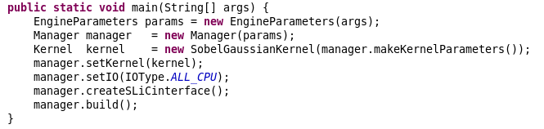
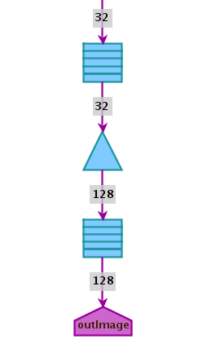
Maxeler Manager Graph

Slide 8
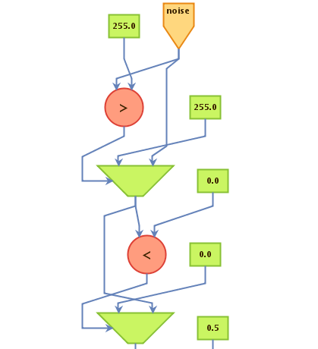
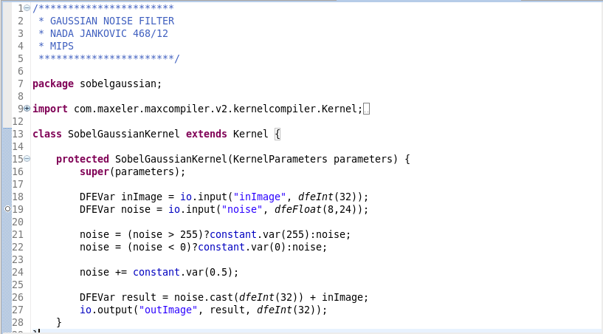
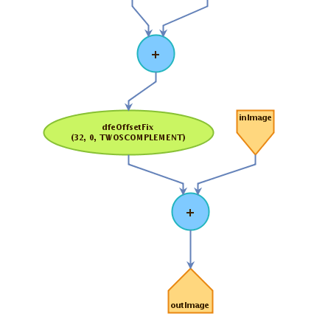
Maxeler Kernel

Slide 9
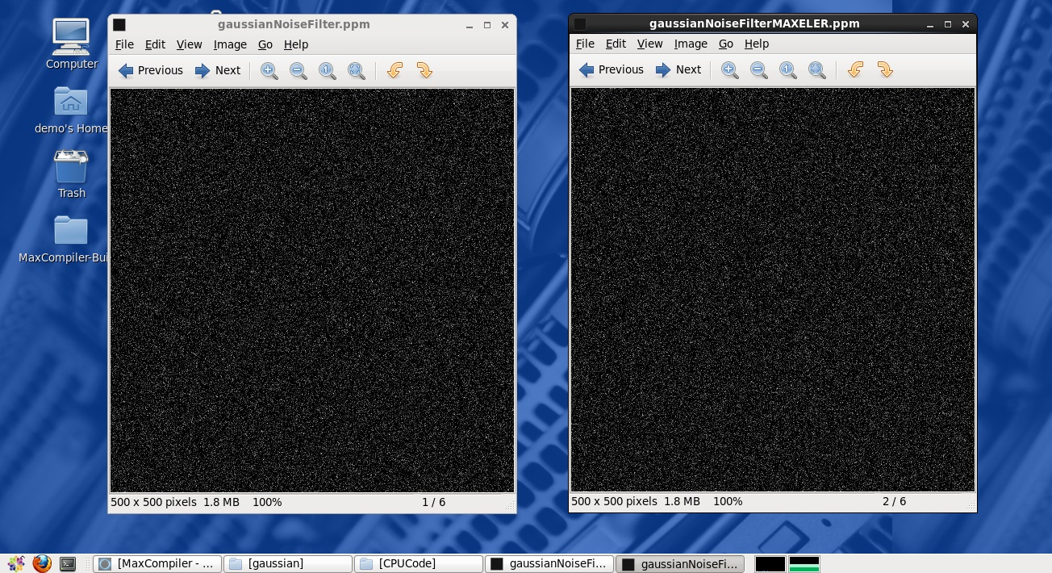

Slide 10


Gaussian Noise in Digital Images

Slide 11
References
J. Daintith, “Gaussian noise”, A Dictionary of Computing, 2004
V.Milutinovic, J. Salom, N. Trifunovic, R. Giorgi, “Guide to DataFlow SuperComputing: Basic Concepts, Case Studies, and a Detailed Example”, 2015
Stanford University, https://www.stanford.edu/
http://appgallery.maxeler.com/#/
https://en.wikipedia.org/wiki/Gaussian_noise

Slide 12


Q & A

